Slide 1


Notes:
Hi,all. Now we gonne talk about our project Shall We talk. First of all, let me introduce our team members, zhanlan or you can me emma. Heminghui … jixunyu ,sometimes we call him fish… huqile

Slide 2




Overview
1
Purpose
2
Audience
3
Use case
4
Screen shots
5
Future development
Notes:
Our presentation includes five parts.

Slide 3
PART 1
一
Purpose
Notes:
And now let huqile introduce the first part ,our Purpose

Slide 4
01
Communicate with friends
Add friends
02
03
Convenient interaction
04
Share things with others

Slide 5
Part 2
二
audience
Notes:
Next ,jixunyu will explain the second part ,our audience

Slide 6
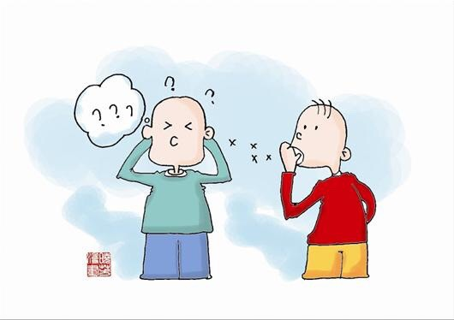
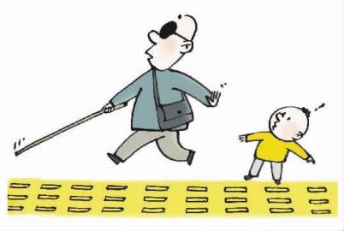
The blind
01
02
Deaf-mute
03
The normal
Notes:
1.The blind
2.Deaf-mute
3.The normal who eager to enter into special crowd

Slide 7
Part 3
三
Use case
Notes:
And then ,heminghui will show us some Use case Scenarios

Slide 8
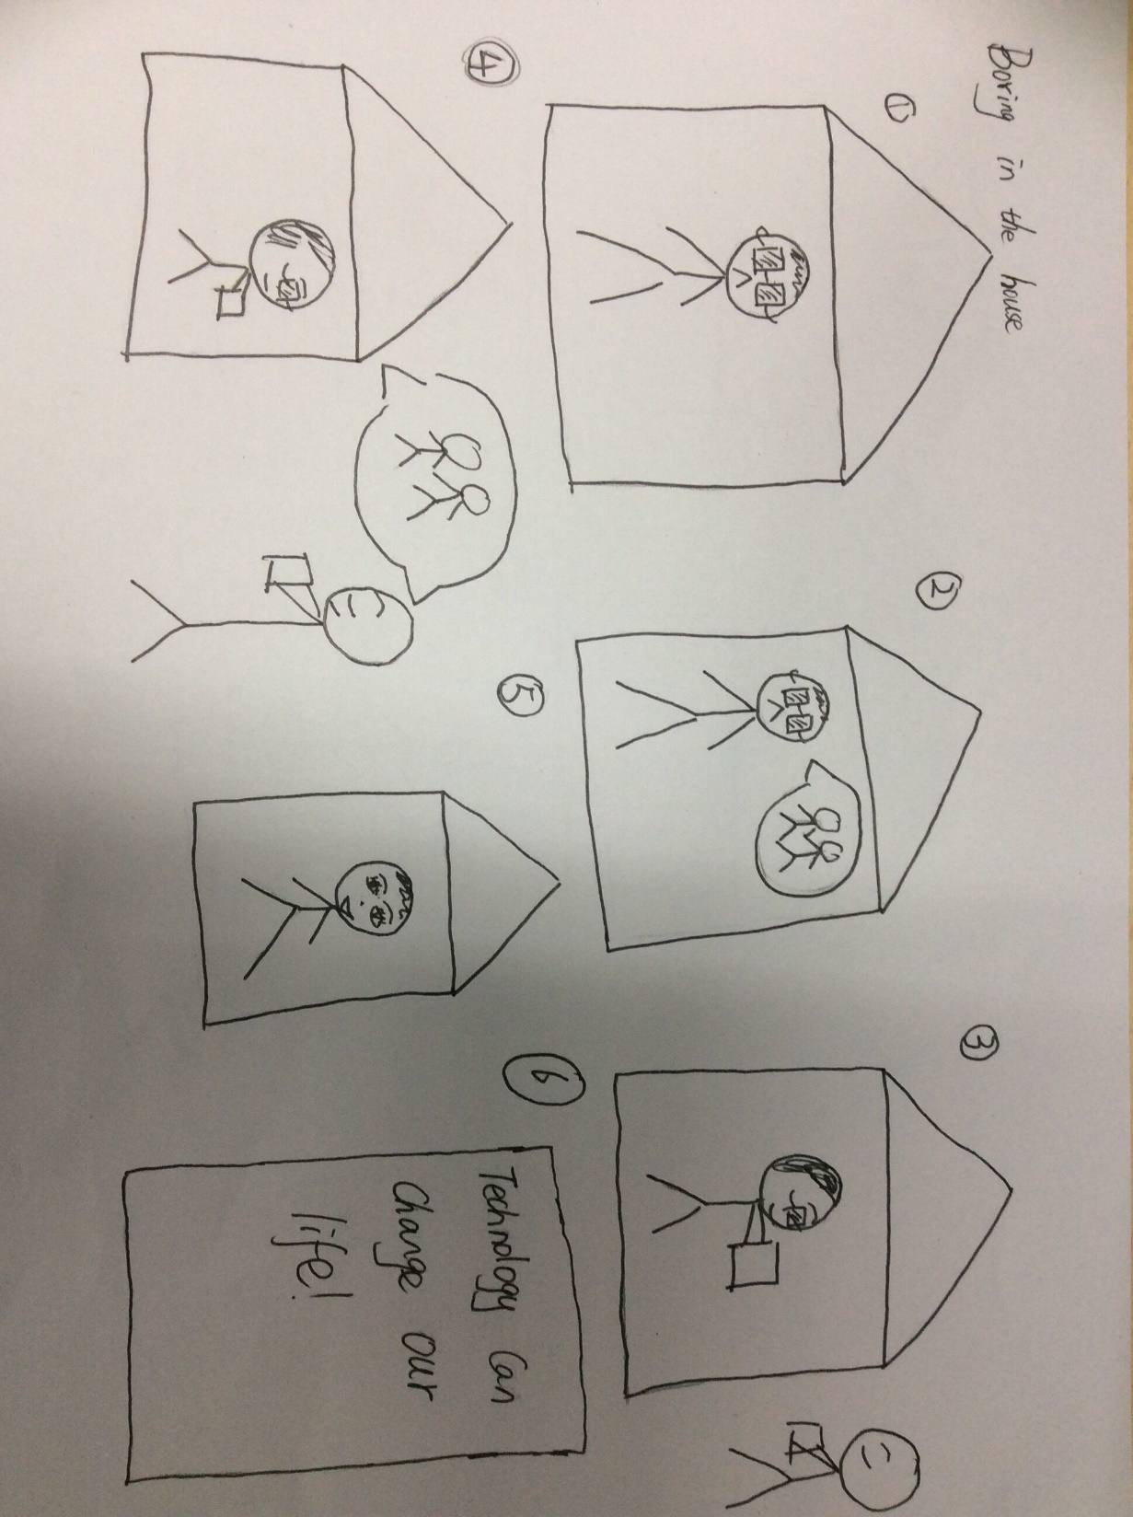
Notes:
The blind feels lonely and boring

Slide 9
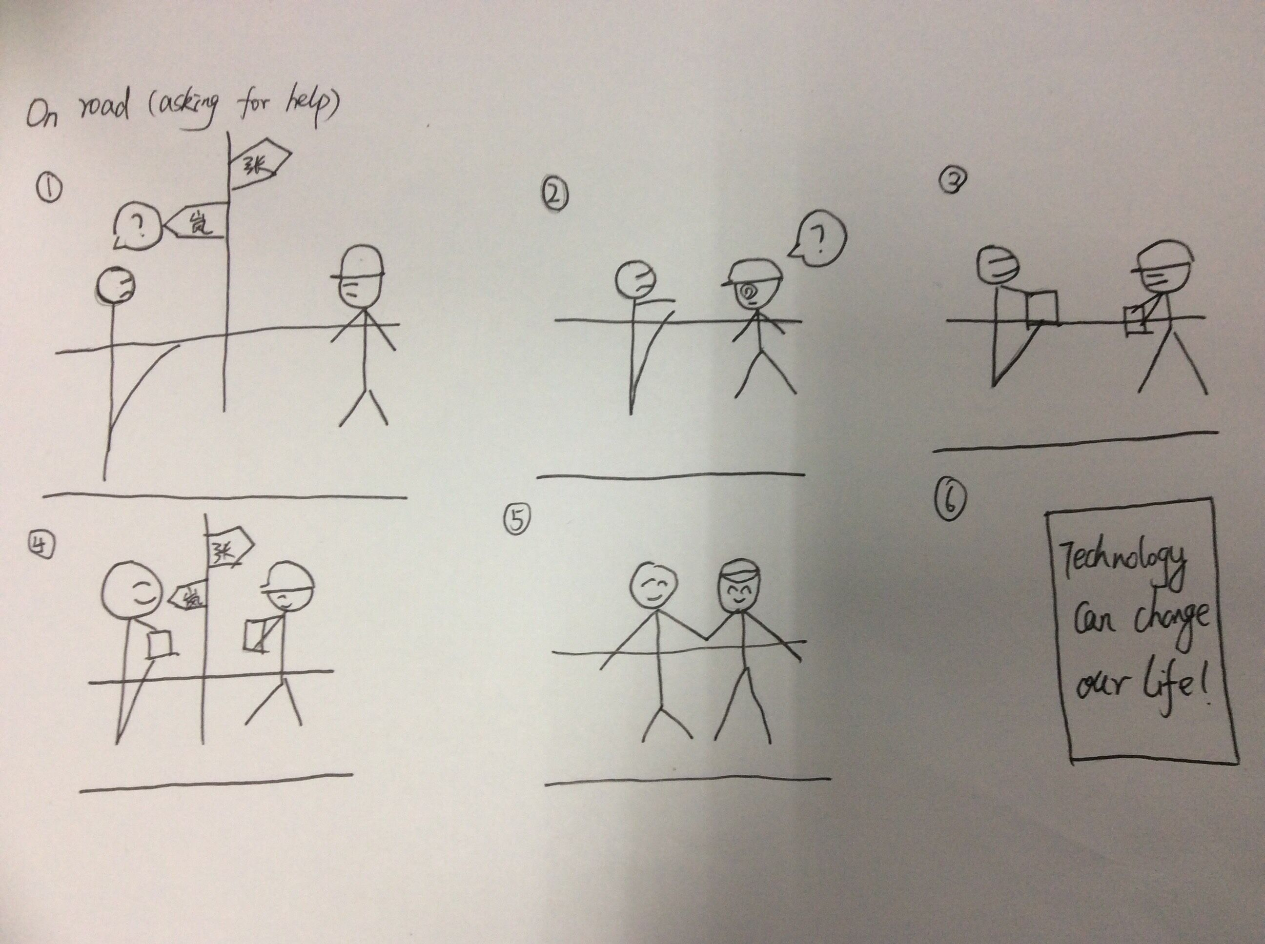
Notes:
The deaf-mute need help, but others can’t understand him

Slide 10
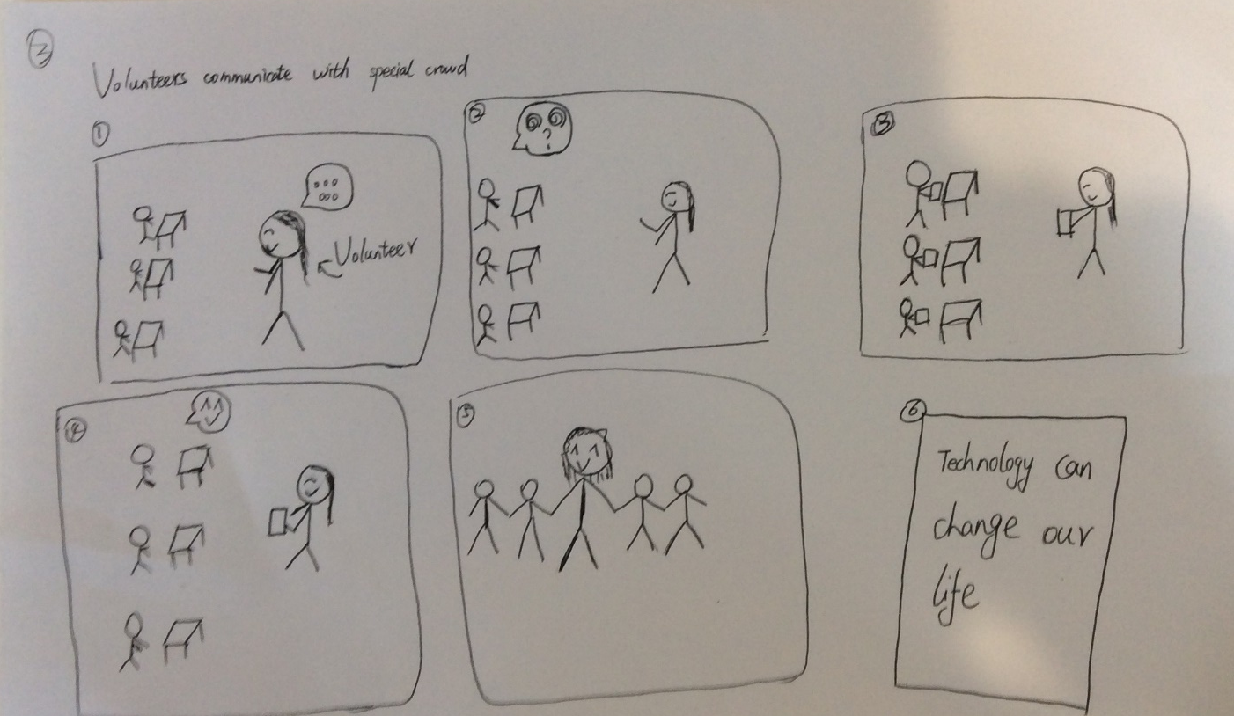
Notes:
Volunteers take care of

Slide 11
PART 4
Screen shots
Notes:
Now it’s show time

Slide 12

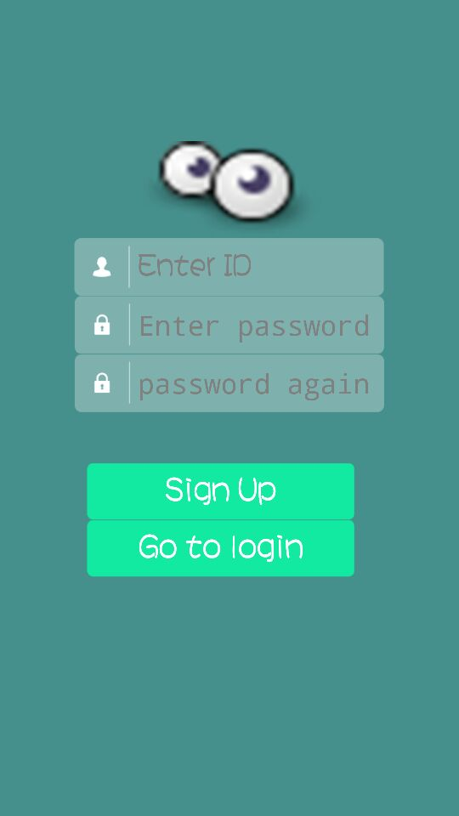
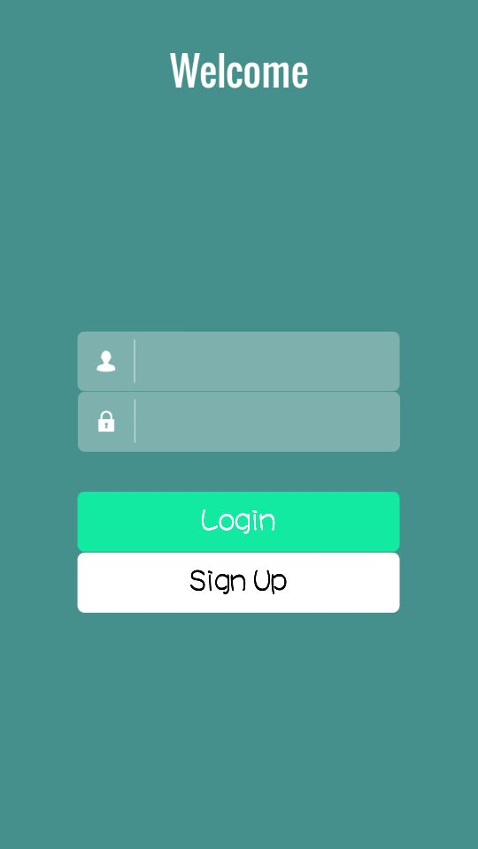
Notes:
The first time we use the app, you need to choose a mode “voice or text” to use the app.If you are the blind ,you might speak the username and password according to the voice hint.

Slide 13
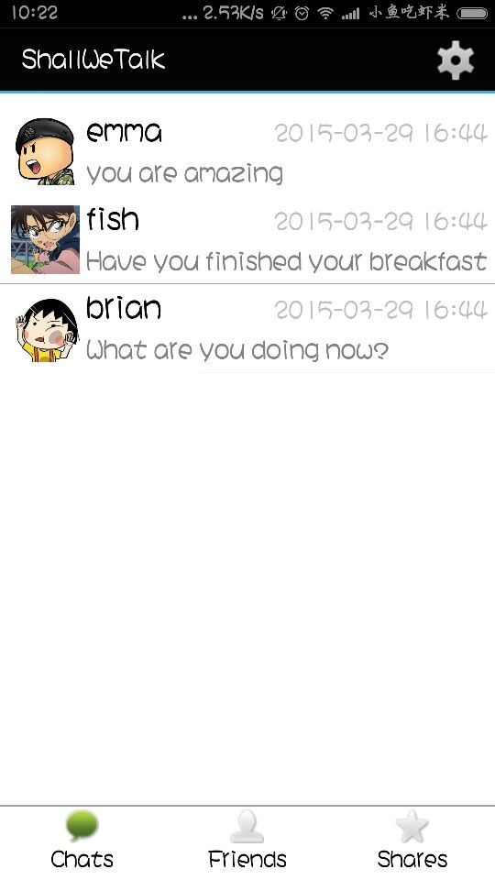
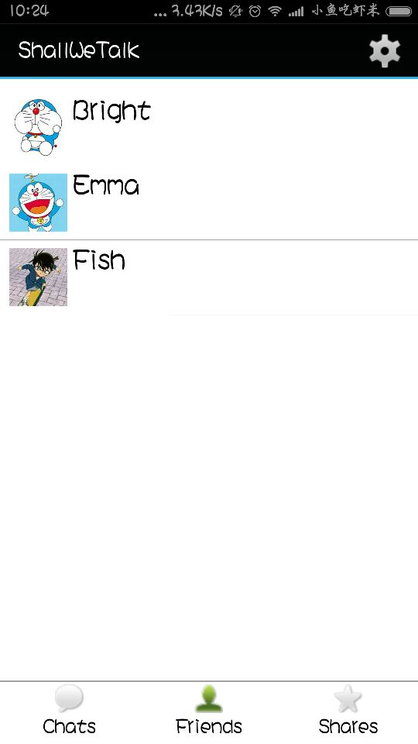
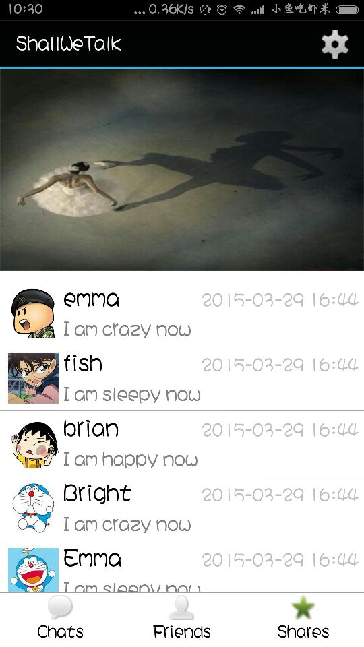
Notes:
After login , the blind can slide to left or right to change the page. The first page shows new messages . The second page shows his/her friends. The last page can show their friends’ moments.he/she can slide up or down to listen the message.
盲人 左右滑动 切换屏幕
上下滑动 读取新消息
长按跳转到聊天页面和the detail of our friends’ news
双击跳转到设置和添加朋友页面

Slide 14
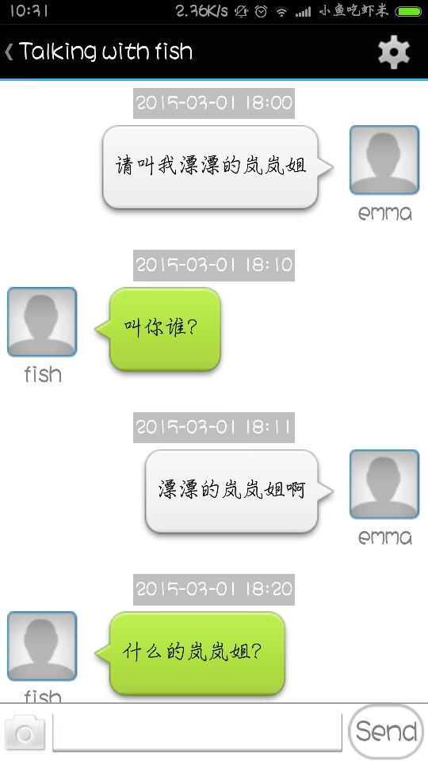
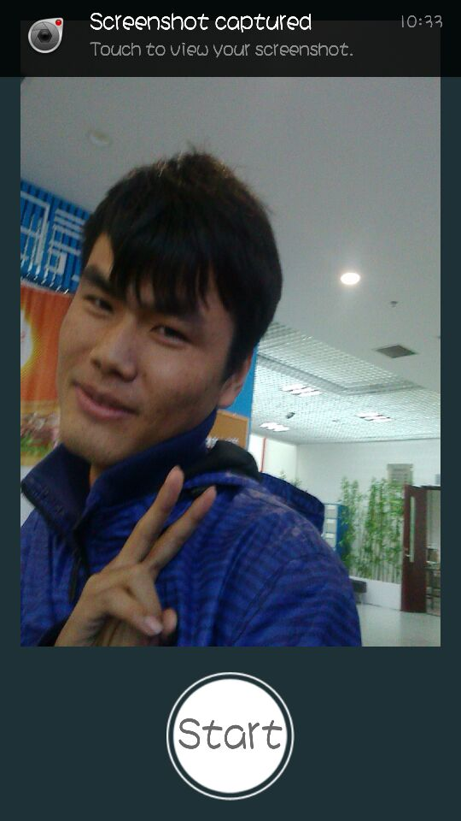
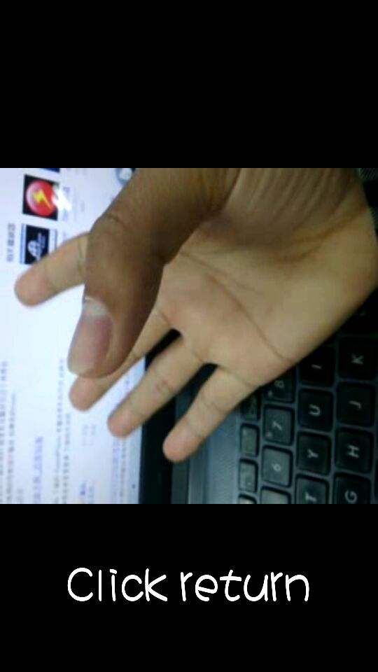
Notes:
Long press the screen can enter the talking page ,the mute can open the camera to input the sign language, click a text and translate it to a video. The blind can long press the screen and just speak,we will translate the voice to text and send to his/her friends.
聋哑人单击内容打开翻译后的手语
打开摄像机录入手语，翻译后发送

Slide 15
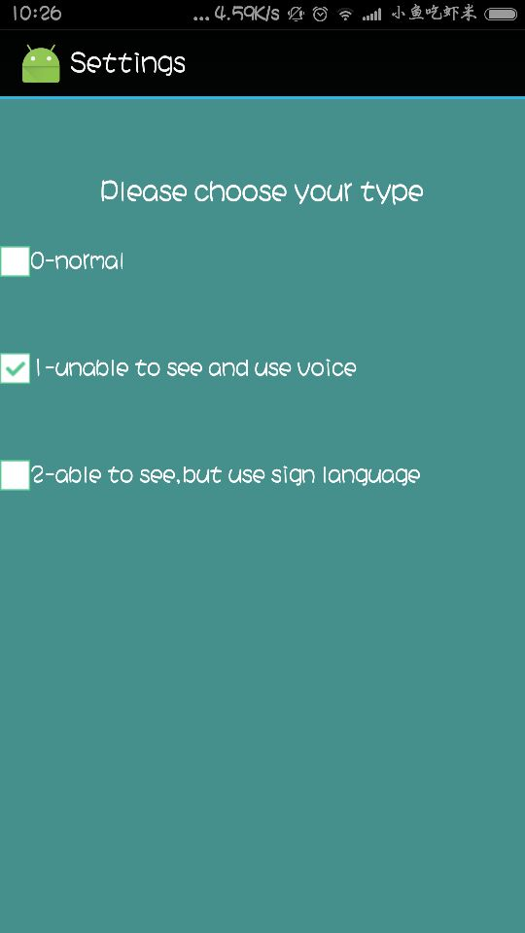


Notes:
Double click to enter the setting page and add friends’ page. He/she can press 、long press and double click to choose a type. shake the mobile to search friends and click or long press the screen to agree or refuse a request.
设置页面通过单击双击长按来选择模式
添加朋友圈，摇一摇，通过双击和长按来添加朋友

Slide 16
PART 5
一
Future development

Slide 17




Next Steps
Step 1
Step 2
Step 3
Step 4
Improve the UI to make it more user-friendly
Complete the sign language for the mute
Test on other devices like IOS
Build the server
Notes:
Finally , our next steps.
1.完成服务器的搭建
2.实现手势转化成文字
3.

Slide 18
Thank you

